Slide 1




KAIROS
SPONSORSHIP
PROGRAM
KAIROS MOTTO:
Listen,
Listen,
Love,
Love...
Matthew 25:37-40
The righteous will say, “When, Lord, did we ever see You hungry and feed You, or thirsty and give You a drink? When did we ever see a stranger and welcome You in our homes, or naked and clothe You? When did we ever see You sick or in prison, and visit You?”
The King will reply, “I tell you, whenever you did this for the least important of these brothers of Mine, you did it for Me.”
Join those who have heard this message...
“...I was in prison and you visited me.”
Matt. 25:36
www.kairosva.org

Slide 2

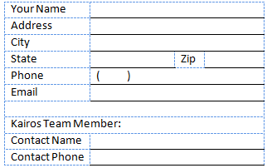

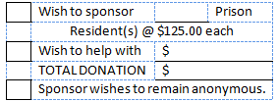

When you
take an
opportunity
to sponsor
a resident of
a Virginia
Correctional
Center
for a
Kairos
Weekend,
you become
a part of this
Ministry.
.
Volunteer team members are required to pay for their own lodging, transportation, and meal expenses for the Kairos weekend events. Some volunteers cannot pay these expenses due to financial hardship. The Kairos team will turn no member away, that is willing to serve, due to lack of finances.
The average cost for a four day weekend is approximately $125. per resident. Additional expenses include training materials, coffee, creamer, napkins, etc.
A total of 42 residents attend the weekend events. If financial assistance is needed, we are able to offer a volunteer sponsorship of $125. for the Kairos weekend.
Your Sponsorship will truly help to change Lives.
We need your information:
Kairos Prison Ministry International is a 501 C3 Corporation. Donations are tax deductible.
Your check should be made payable to:
KAIROS PRISON MINISTRY INTERNATIONAL – VA CHAPTER
www.kairosva.org

